Slide 1

Evaluating Uncertainty in Multiple Dimensions of Data Quality
John L. Eltinge
Assistant Director for Research and Methodology
John.L.Eltinge@census.gov
FCSM Virtual Conference – November 2, 2021
Session A-4: Communication of Uncertainty
in Official Statistics

Slide 2
Acknowledgements and Disclaimer
The author thanks participants in several FCSM-WSS data quality workshops and National Academies workshops on data quality, and other colleagues in statistical agencies, academia and the private sector in numerous countries for helpful discussions of the questions considered in this presentation.
The views expressed here are those of the speaker and do not represent the policies of the United States Census Bureau.

Slide 3
Overview: Evaluating Uncertainty in Multiple Dimensions of Data Quality
Types of Uncertainty:
Impact on Multiple Dimensions of Data Quality
Quantifiable and Inherently Qualitative
Components of Data Quality
Application to Integration of Multiple Data Sources

Slide 4
I. Uncertainty in Statistical Information Production
Production and Use of Statistical Information: Uncertainties in
Who: Principal data users – information base, utility functions
What: Estimands and inferential questions
Description, comparison, prediction, causality, control
How: Data sources, methodology and technology
Resulting properties and “fitness for use” (use value, option value)?
Notes:
Per AAPOR 2020 discussion with Peter Miller et al, flesh out the notions of “fitness for use” especially:
1.Landscape notion – the “fitness for use” use cases help to flesh out the broadly stated conceptual landscape that defines our notions of quality
2.Discuss impact on practical design designs that may flow from a “total quality” approach based on, respectively, (a) a broadly stated general principles approach; or (b) a more focused “fitness for use” approach that highlights certain use cases flowing from specified high-priority stakeholders and their needs. Acknowledge the Peter Miller concern that approach (b) can be too confining, and lead to an excessively cautious approach; but also suggest that approach (a) can be so broadly stated as to be motherhood-and-apple-pie platitudes, and not really reflecting important distinctions that can inform difficult trade-off decisions.
In addition, acknowledge the Peter Miller idea that we hope (?) that many key stakeholders have some respect for technical expertise, and thus have some willingness to defer to the judgment of certain technical experts about design and quality decisions, conditional on certain broad guidelines provided through (a). Note the connections of this with some ideas in Tukey (1962), but also note limitations on this approach, and the risk that it can strike some key stakeholders as excessively high-handed. Note certain degrees of transparency that can be considered, and trade-offs between degree of transparency and cost. Argue that to some degree, transparency has two related benefits: (i) in specified areas, it can help reduce the risk that we are kidding ourselves, per the Richard Feynman (? Check source) suggestion that the scientific methods is the best way we have to keep from kidding ourselves; and (ii) in other specified areas, and under certain societal conditions that amount to a low-trust environment, increased transparency in specified areas can increase the general trust in the statistical organization – helps to get the organization back to an equilibrium of trust, at least to some degree.

Slide 5
I. Uncertainty: Multiple Dimensions of Data Quality
Umbrella Categories: Who-What-How → Properties
Brackstone (1999), NASEM (2017), Eurostat (2019), FCSM (2020)
Accuracy
Comparability (within & across products)
Granularity (cross-sectional & temporal)
Punctuality (from reference date)
Relevance (conceptual & operational)
Interpretability (via metadata)
Accessibility (diverse user groups)

Slide 6
I. Uncertainty: Practical Impact of Data Quality Assessment
Value for Current Data Users
“Fitness for use”
Natural dependence on context
(users and intended uses)
Consider both use value and option value
B. Traction for Improvement in Future Work

Slide 7
II. Quantifiable and Inherently Qualitative Components of Data Quality (1)
Most (all?) of these seven dimensions have complementary
components - respectively:
Quantifiable (at least in principle)
Inherently qualitative
Total Survey Quality – Biemer & Lyberg (2003), Dever et al. (2019)
Cf. some economists’ distinction between “risk”
(quantifiable) and “uncertainty” (per “black swans”)

Slide 8
II. Quantifiable Components of Data Quality
Intended uses of data: Empirical quality indicators for each?
1. Formal inference for pre-specified estimands
(e.g., county means); cf. study registration
2. Exploratory analysis for the pre-specified estimands (e.g., cluster analysis of county means)
3. Highly exploratory analysis of microdata, without firm pre-specification of estimand set – properties?

Slide 9
II. Inherently Qualitative Components of Data Quality
Possibility of Fundamentally Irreconcilable Views on Trade-Offs
among Competing Components (Accuracy/Relevance/Timeliness)
1. Use cases with potentially “game changing” differences:
- Overall (broad groups of estimands, users, environments)
- In niches (a few key estimands, user groups)
2. Conceptual parallels with “wicked problems” in design:
Concerns for public-stewardship consensus-based decisions
(Rittel & Weber, 1973; Buchanan, 1992; Thienen et al., 2014)

Slide 10
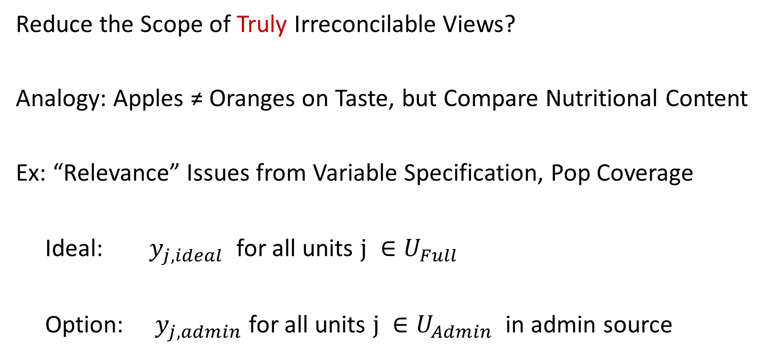
II. Refining “Inherently Qualitative” Assessments (1)
Reduce the Scope of Truly Irreconcilable Views?
Analogy: Apples ≠ Oranges on Taste, but Compare Nutritional Content
Ex: “Relevance” Issues from Variable Specification, Pop Coverage
Ideal: $y_{j, ideal}$ for all units $j ∈U_{Full}$
Option: $y_{j, admin}$ for all units $j ∈U_{Admin}$ in admin source

Slide 11
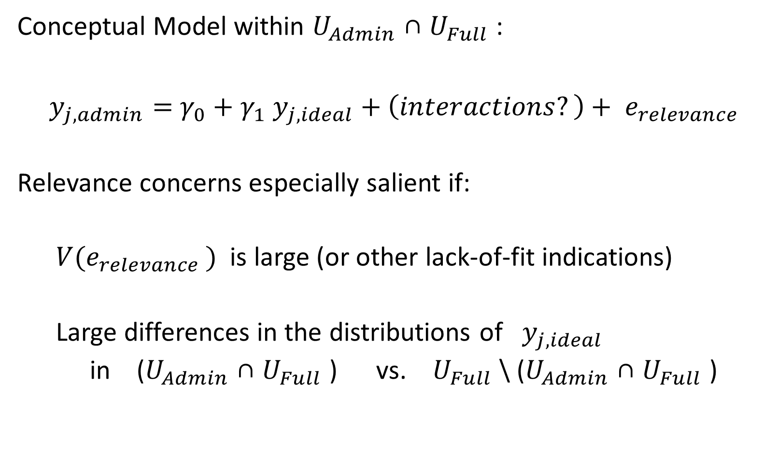
II. Refining “Inherently Qualitative” Assessments (2)
Conceptual Model within $U_{Admin}$ ∩ $U_{Full}$ :
$y_{j, admin}=$ ${γ_{0}+γ_{1} y_{j, ideal}+\left(interactions?\right)+ e_{relevance }}^{}$
Relevance concerns especially salient if:
${V(e}_{relevance })$ is large (or other lack-of-fit indications)
Large differences in the distributions of $y_{j, ideal}$
in ($U_{Admin}$ ∩ $U_{Full}$ ) vs. $U_{Full}$ \ ($U_{Admin}$ ∩ $U_{Full}$ )

Slide 12
III. Application to Integration of Multiple Data Sources (1)
Combine survey data with “non-designed data”
(“organic” “big data”: Groves, 2012; Couper, 2013;
Citro, 2014; CNSTAT, 2017b, many others)
1. Many sources of variability
2. All seven dimensions of data quality matter

Slide 13
III. Multiple Data Sources (2)
B. Many examples (adaptive design; append data; edit; imputation)
C. Focus here: “backbone and bridge”:
“Backbone”: Administrative record sets
“Bridge”: Supplementary sample surveys to “fill in the
gaps” (calibrate definitions; cover missing groups)
Ex: Current Employment Survey; small domain est

Slide 14
III. Multiple Data Sources (3)
D. Accuracy (MSE – TSE; interval properties): Quantitative
Population coverage for each data source;
overlap (multiple-frame “domain sizes”)?
Incomplete-data patterns (unit, period, item)
and related record-linkage quality?
Quality of model fit, per small domain literature
(e.g., Rao and Molina, 2015)
Qualitative: Original goals & management of source – Implications for error diagnosis and control?

Slide 15
III. Multiple Data Sources (4)
Comparability: Unit-level conceptual model with
terms reflecting differences in concepts captured
through multiple sources
Quantitative: Sufficient identifying information
to estimate key terms in the conceptual model?
Qualitative: Model identification information unavailable;
try Bayesian elicitation (O’Hagan et al., 2006)?

Slide 16
III. Multiple Data Sources (5)
F. Cross-Sectional and Temporal Granularity
Quantitative: Unit-level model with classificatory
(e.g., demographic), spatial and time effects
Qualitative: Important scientific insights or policy
decisions fundamentally aligned with finer structure?
(Cf. debates over “personalized medicine” vs.
broad public-health interventions; funding allocation)

Slide 17
III. Multiple Data Sources (6)
Punctuality
Quantitative: Unit-level model for volatility of key estimands,
on time scale aligned with publication lags
Qualitative: More punctual estimates support better decisions? Use cases? Trade-offs with other quality dimensions?
Ex: Recent Household Pulse and Small Business Pulse Surveys
Ex: Consumer price index – annual, monthly, hourly?

Slide 18
III. Multiple Data Sources (7)
H. Relevance: Unit-level models to assess “distance” of
idealized concept (income, health status, education)
from measures available in different data sources
Quantitative: Models based on direct comparison;
latent-variable distance
Qualitative: Analyze admin record goals & processes

Slide 19
III. Multiple Data Sources (8)
Interpretability: Depth, uniformity & management of metadata
across multiple sources: Standardization? Harmonization?
Accessibility:
Access constraints degrade quality of analysis, relative to ideal?
Intersection with full cost structure of data analysis and use
(negotiation, linkage, calendar time, clock time, learning curves)

Slide 20
IV. Summary: Uncertainty and Data Quality
Quantitative and Qualitative Components of:
Accuracy, Comparability, Granularity, Punctuality,
Relevance, Interpretability, Accessibility
B. Partial Unification Through Quantifiable Components
C. Application to “Backbone and Bridge” Case

Slide 21
Thank You!
John L. Eltinge
Assistant Director for Research and Methodology
U.S. Census Bureau
John.L.Eltinge@census.gov
Notes:
Thank you.

Slide 22
References
Andersen, R., J. Kasper, M.R. Frankel and Associates (1979). Total Survey Error. San Francisco: Jossey-Bass.
Biemer, P.P. (2010). Total Survey Error: Design, Implementation and Evaluation. Public Opinion Quarterly 74, 817-848.
Biemer, Paul P., Edith de Leeuw, Stephanie Eckman, Brad Edwards, Frauke Kreuter, Lars E. Lyberg, N. Clyde Tucker, Brady T. West (Editors) (2017). Total Survey Error in Practice. New York: Wiley.
Biemer, Paul P. and Lars E. Lyberg (2003). Introduction to Survey Quality. New York: Wiley.
Brackstone, Gordon (1999). Managing Data Quality in a Statistical Agency. Survey Methodology 25, 139-149.

Slide 23
Bradley, Valerie C., Shiro Kuriwaki, Michael Isakov,Dino Sejdinovic, Xiao-Li Meng, Seth Flaxman (2021). Are We There Yet? Big Surveys Signiﬁcantly Overestimate COVID-19 Vaccination in the US. Available through: [2106.05818] Are We There Yet? Big Surveys Significantly Overestimates COVID-19 Vaccination in the US (arxiv.org)
Buchanan, Richard (1992). Wicked Problems in Design Thinking. Design Issues, 8 (2), 5-21
Citro, Constance F. (2014). From Multiple Modes for Surveys to Multiple Sources for Estimates. Survey Methodology Journal 40, 137-161.
Daily, Donna (2021). American Community Survey: Impact from the Pandemic. Presentation to the Census Scientific Advisory Committee, September 23, 2021. Available through: American Community Survey Experience (census.gov)

Slide 24
Dever, Jill A., Ashley Amaya, Anup Srivastav, Peng-Jun Lu, Jessica Roycroft, Marshica Stanley, M Christopher Stringer, Michael G Bostwick, Stacie M Greby, Tammy A Santibanez, Walter W Williams (2021). Fit for Purpose in Action: Design, Implementation, and Evaluation of the National Internet Flu Survey, Journal of Survey Statistics and Methodology, Volume 9, Issue 3, June 2021, Pages 449–476, https://doi.org/10.1093/jssam/smz050
Elliott, Michael R. and Richard Valliant (2017). Inference for Nonprobability Samples. Statistical Science 32, 249-264
Eltinge, John L. (2013). Integration of matrix sampling and multiple-frame methodology. Proceedings of the 59th World Statistical Congress. https://www.statistics.gov.hk/wsc/IPS033-P4-S.pdf
Federal Committee on Statistical Methodology (2020). A Framework for Data Quality. FCSM Report 20-04. Available through: https://resources.data.gov/keywords/fcsm/
Goroff, Daniel (2020). Data Dreams and the Everyday Economics of Evidence, Inference and Governance. ASA Links Award Lecture, December 8, 2020. Available through: https://www.amstat.org/ASA/Your-Career/Awards/Links-Lecture-Award.aspx

Slide 25
Groves, Robert M. and Lyberg, Lars E. (2010). Total Survey Error: Past, Present, and Future, Public Opinion Quarterly, Volume 74, Issue 5, 2010, Pages 849–879, https://doi.org/10.1093/poq/nfq065
Imbens, Guido W. and Donald B. Rubin (2015). Causal Inference for Statistics, Social and Biomedical Sciences: An Introduction. New York: Cambridge University Press.
Ioannidis, John P.A. (2005). Why Most Published Research Findings Are False. PLOS Medicine 2(8): e124. https://doi.org/10.1371/journal.pmed.0020124
Lavrakas, Paul (2021). Discussion of Session 1 – 2021 International Total Survey Error Workshop. September 24, 2021.
Lindberg, T., Köppen, E., Rauth, I. & Meinel, C. (2012). On the Perception, Adoption and Implementation of Design Thinking in the IT Industry. In H. Plattner, C. Meinel and L. Leifer (Eds.), Design Thinking Research. Studying Co-Creation in Practice (229-240). Berlin: Springer.
Lohr, Sharon L. (2011). Alternative Survey Sample Designs: Sampling with Multiple Overlapping Frames. Survey Methodology 37, 197-213.

Slide 26
Lohr, Sharon L. (2018). Measuring Uncertainty with Multiple Sources of Data. Proceedings of Statistics Canada Symposium 2018.
Lohr, Sharon L and Trivellore E. Raghunathan (2017). Combining Survey Data with Other Data Sources. Statistical Science 32, 293-312
Meng, Xiao-Li (2018). Statistical Paradises and Paradoxes in Big Data (I): Law of Large Populations, Big Data Paradox and the 2016 U.S. Presidential Election. Annals of Applied Statistics 1-42.
National Academies of Sciences, Engineering, and Medicine (2017). Federal Statistics, Multiple Data Sources, and Privacy Protection: Next Steps. Washington, DC: The National Academies Press. https://doi.org/10.17226/24893.
National Academies of Sciences, Engineering, and Medicine (2019a). Reproducibility and Replicability in Science. Washington, DC: The National Academies Press. https://doi.org/10.17226/25303

Slide 27
National Academies of Sciences, Engineering, and Medicine (2019b). Methods to Foster Transparency and Reproducibility of Federal Statistics: Proceedings of a Workshop. Washington, DC: The National Academies Press. https://doi.org/10.17226/25305
National Academies of Sciences, Engineering, and Medicine (2021). Principles and Practices for a Federal Statistical Agency: Seventh Edition. Washington, DC: The National Academies Press. https://doi.org/10.17226/24810
O’Hagan, A., C.E. Buck, A. Daneshkhah, J.R. Eiser, P.H. Garthwaite, D.J. Jenkinson, J.E. Oakley and T. Rakow (2006). Uncertain Judgements: Eliciting Experts' Probabilities. Chichester: Wiley.
Rao, J.N.K. and I. Molina (2015). Small Area Estimation, Second Edition. New York: Wiley.
Rothbaum, Jonathan (2021). Nonresponse Bias During the Pandemic. Presentation to the Census Scientific Advisory Committee, September 23, 2021. Available through: Current Population Survey Experience (census.gov)

Slide 28
Steorts, Rebecca (2015). Entity Resolution with Empirically Motivated Priors. Bayesian Analysis 10, 849-875.
Stodden, V, F. Leisch and R.D. Peng (2014). Implementing Reproducible Research. London: CRC Press
Thienen, J. P. A. von, Meinel, C. & Nicolai, C. (2014). How design thinking tools help to solve wicked problems. In H. Plattner, C. Meinel and L. Leifer (eds.), Design thinking research. Building innovation eco-systems (97-102). Berlin: Springer.
Wasserstein, Ronald L. and Nicole A. Lazar (2016). The ASA Statement on p-Values: Context, Process, and Purpose, The American Statistician, 70:2, 129 133, DOI: 10.1080/00031305.2016.1154108 https://amstat.tandfonline.com/doi/full/10.1080/00031305.2016.1154108#.X9P1ifk3nIU

